Slide 1
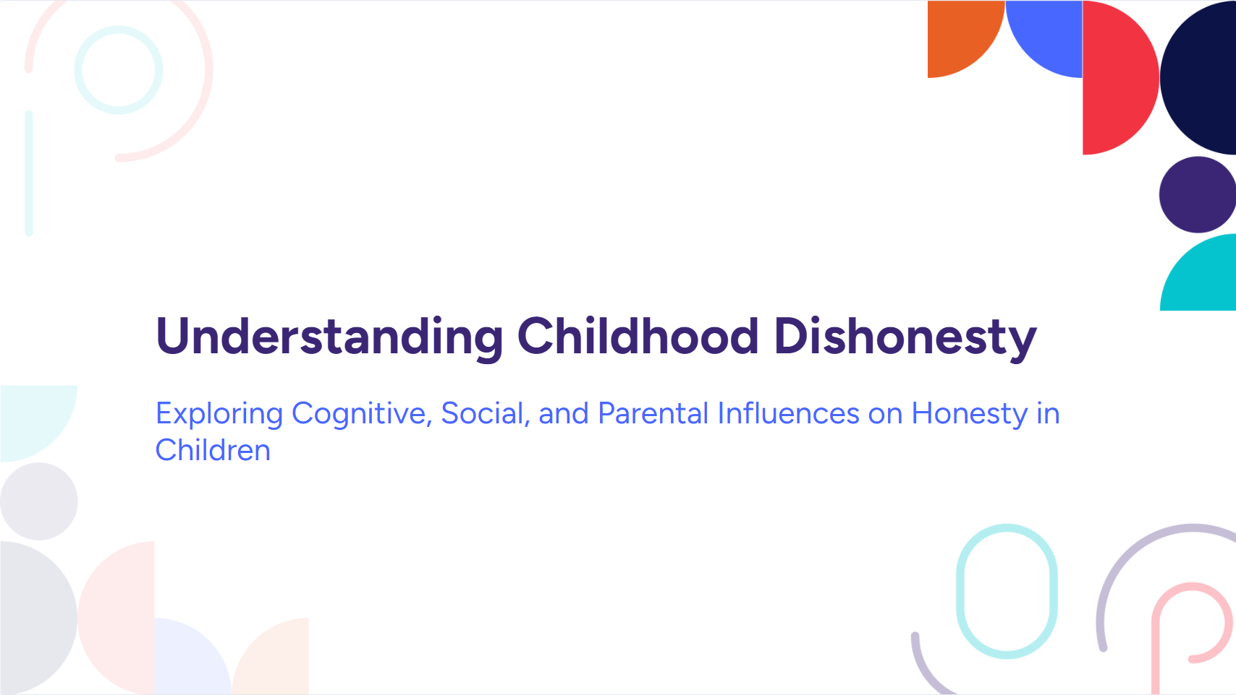
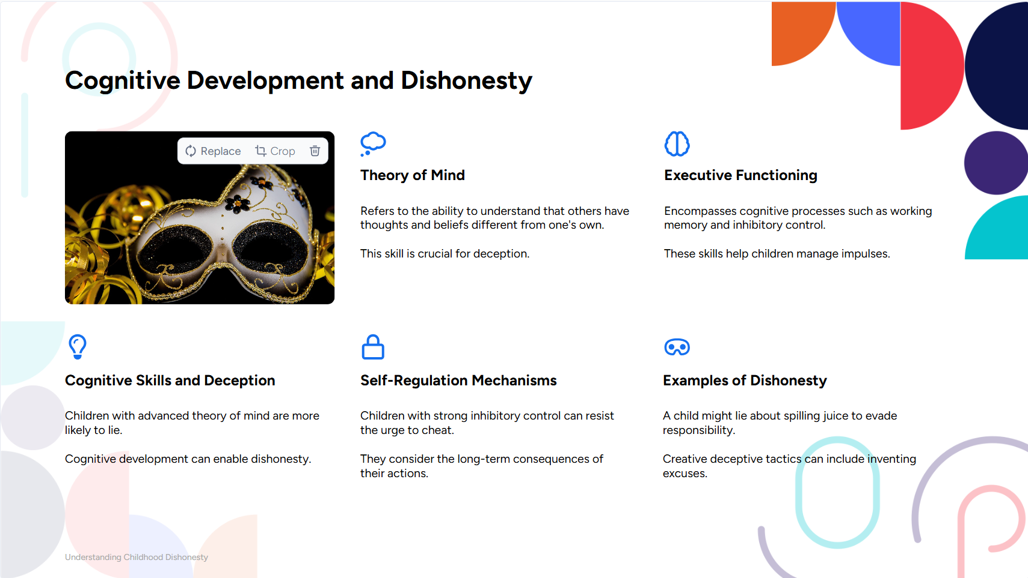
By Felix Egan

Slide 2
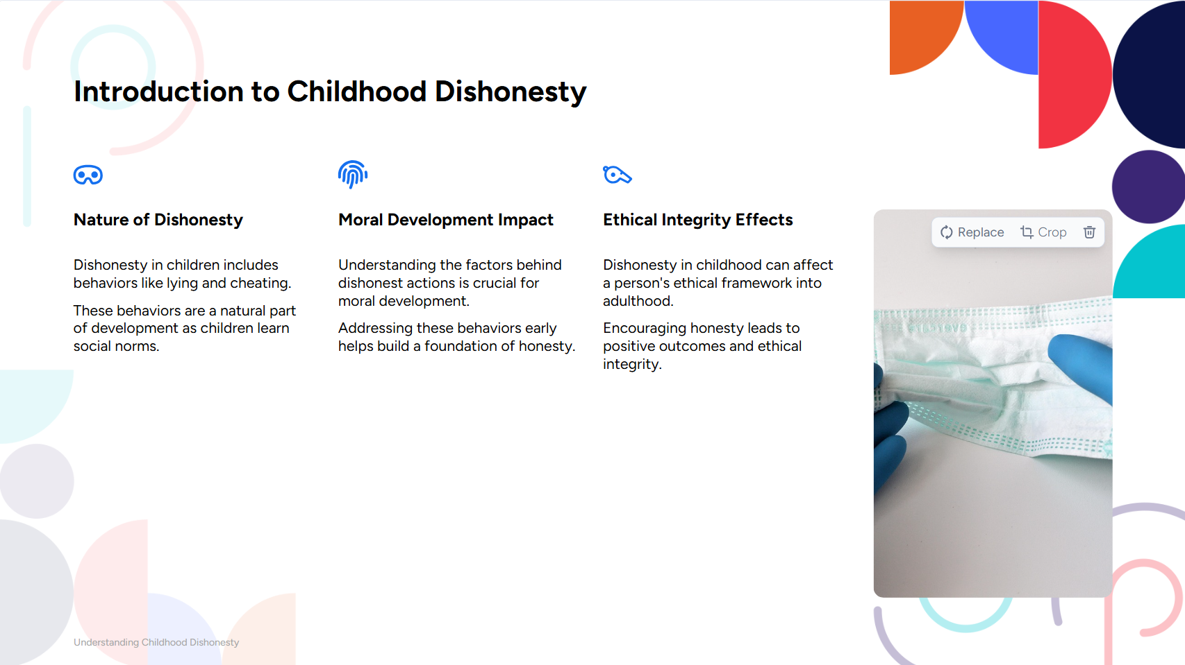




Slide 3
Thesis Statement:
Children's cheating and lying behaviors are significantly influenced by their cognitive development, the examples set by their parents, and the intricate relationship between lying and other behavioral challenges.

Slide 4







Slide 5
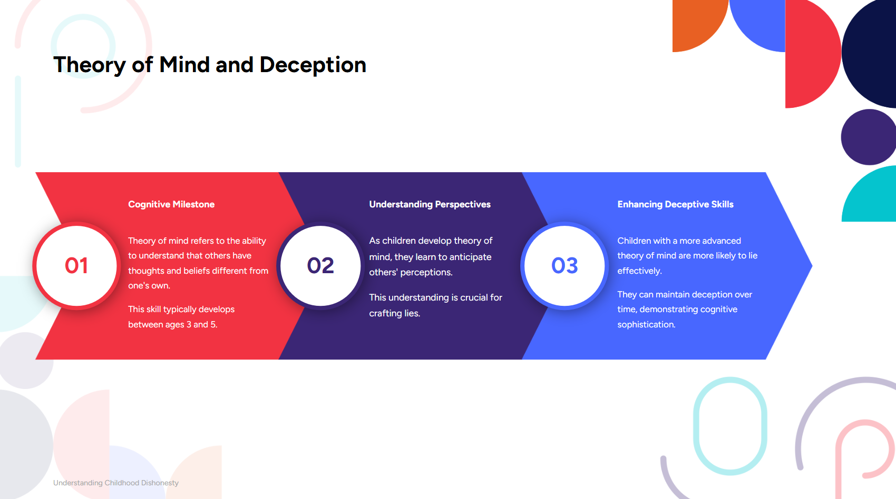


Slide 6
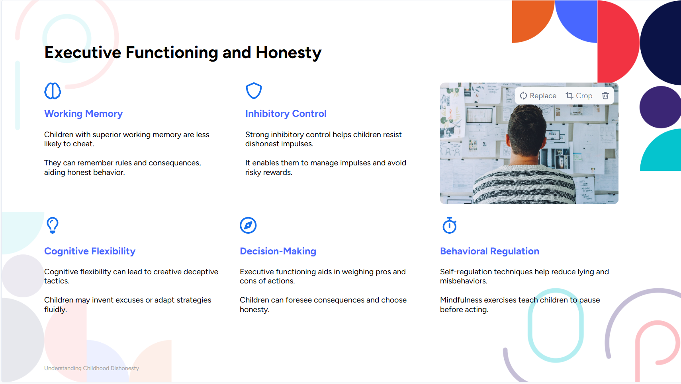
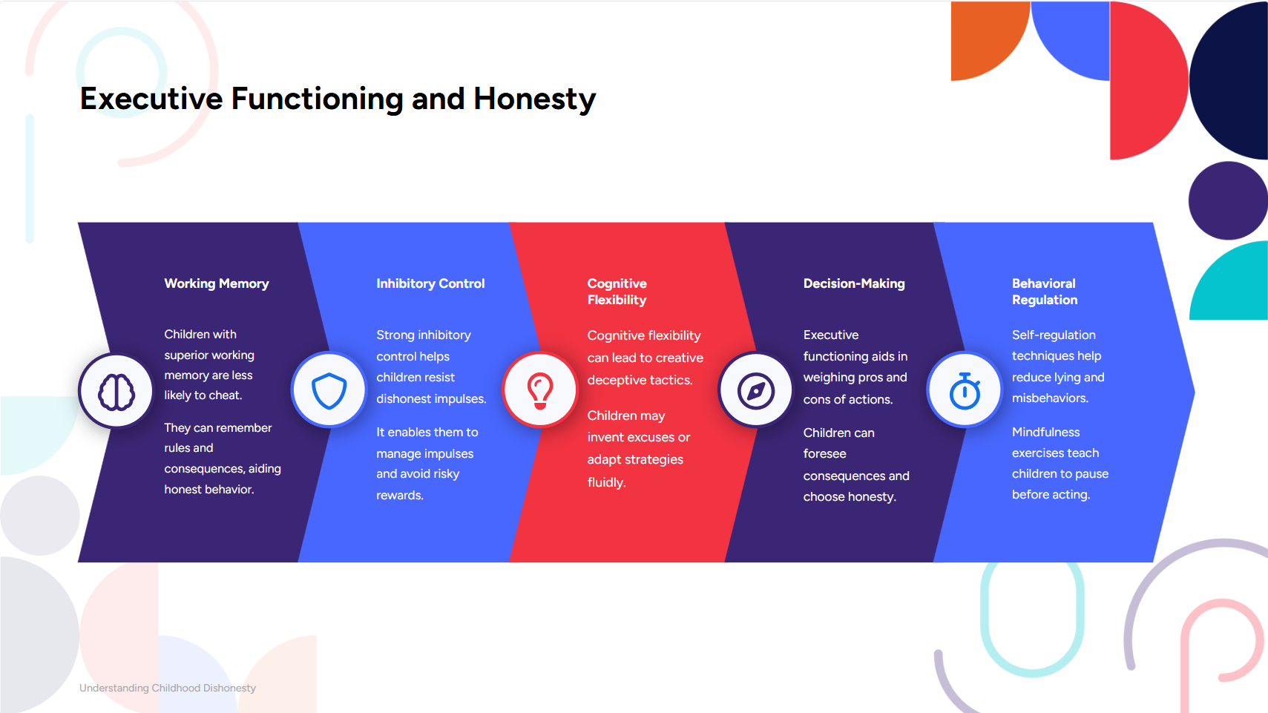
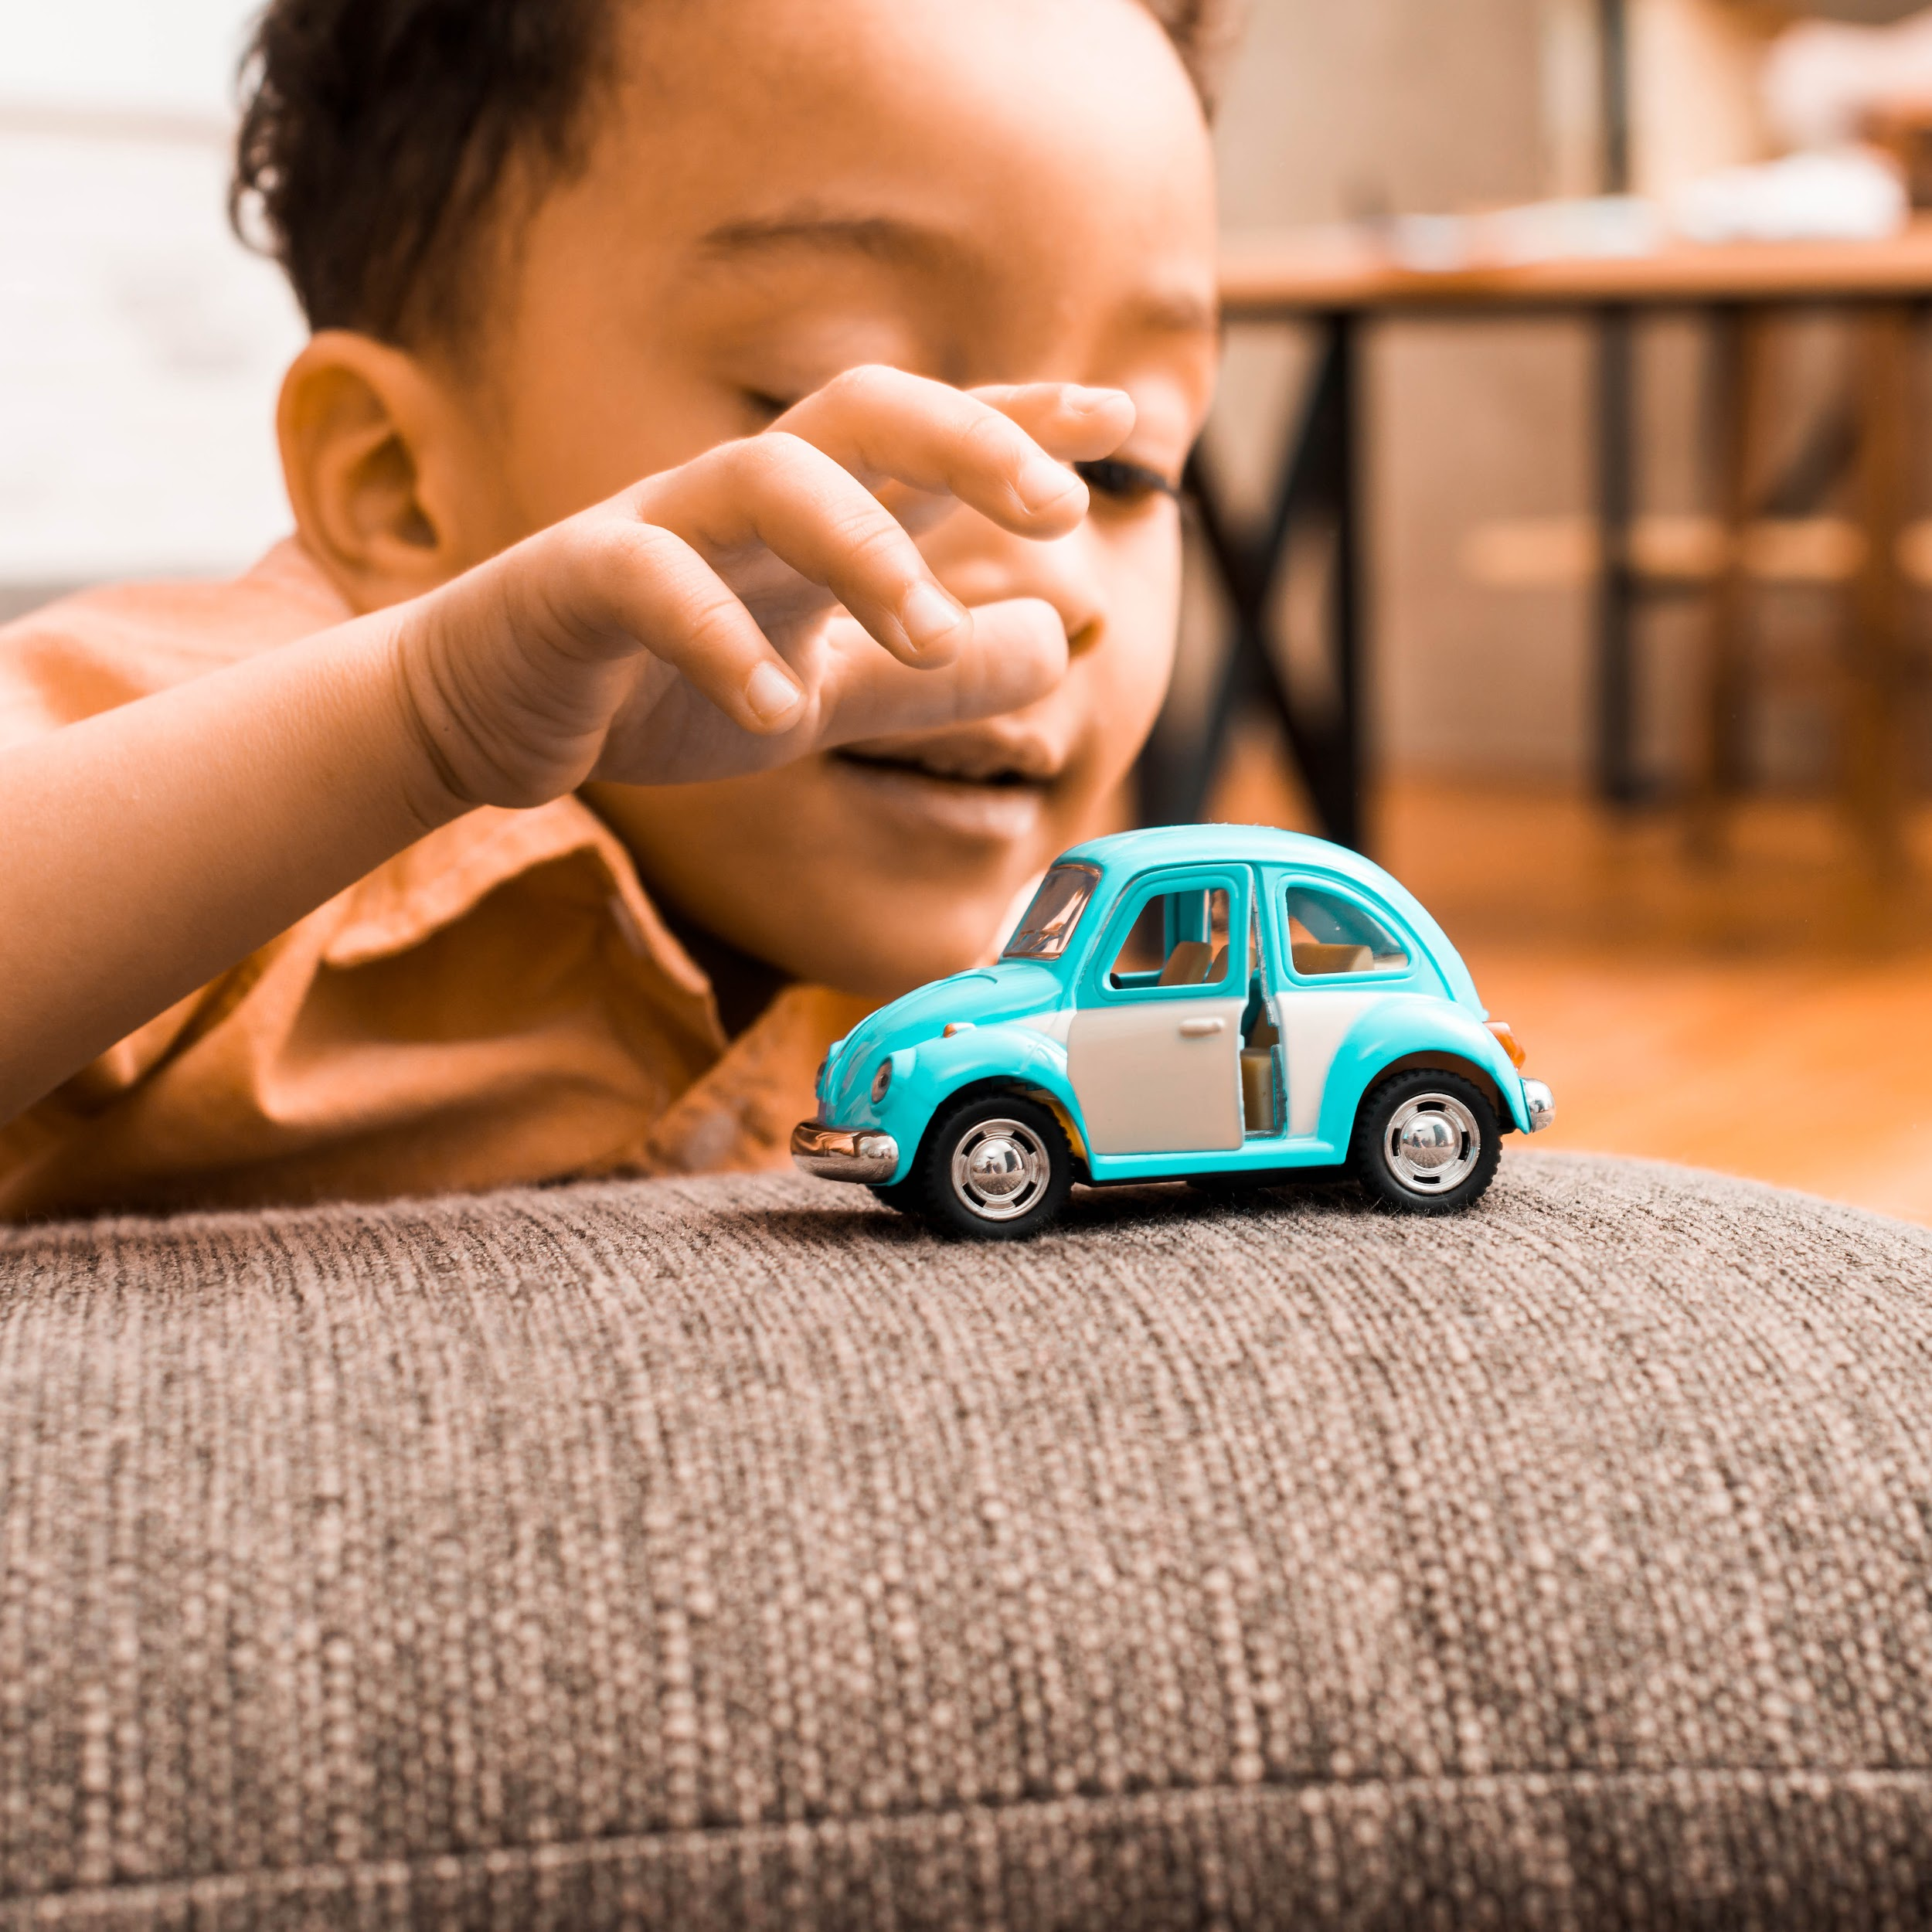








Slide 7
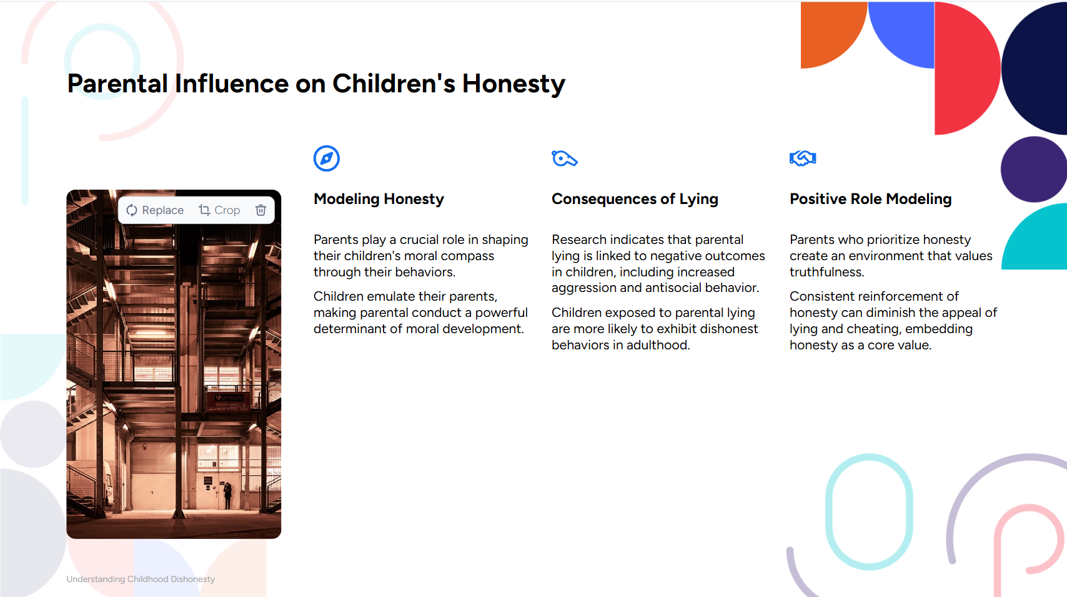
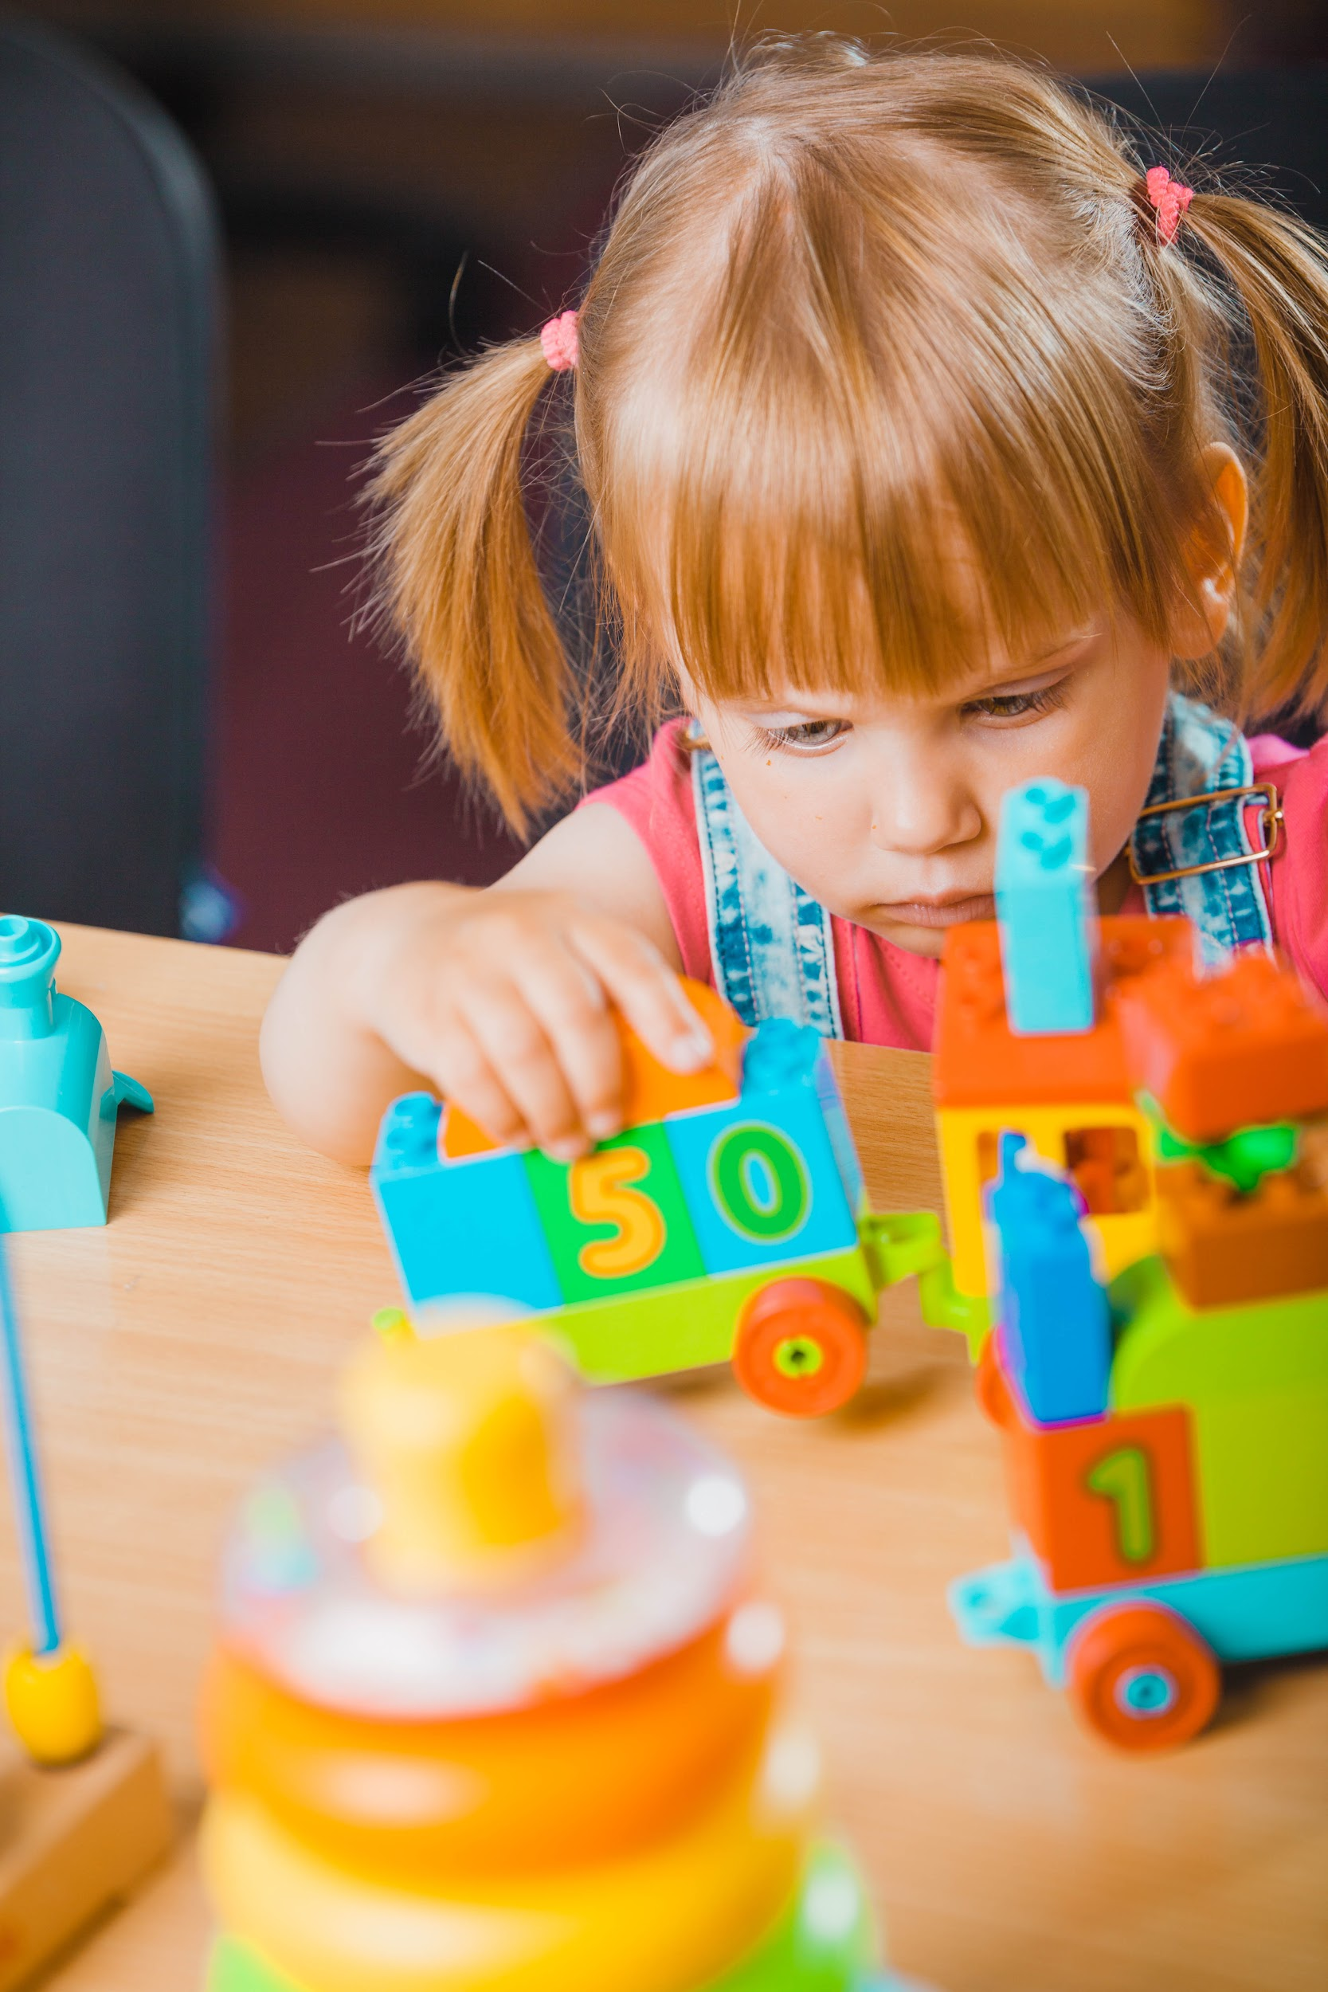




Slide 8
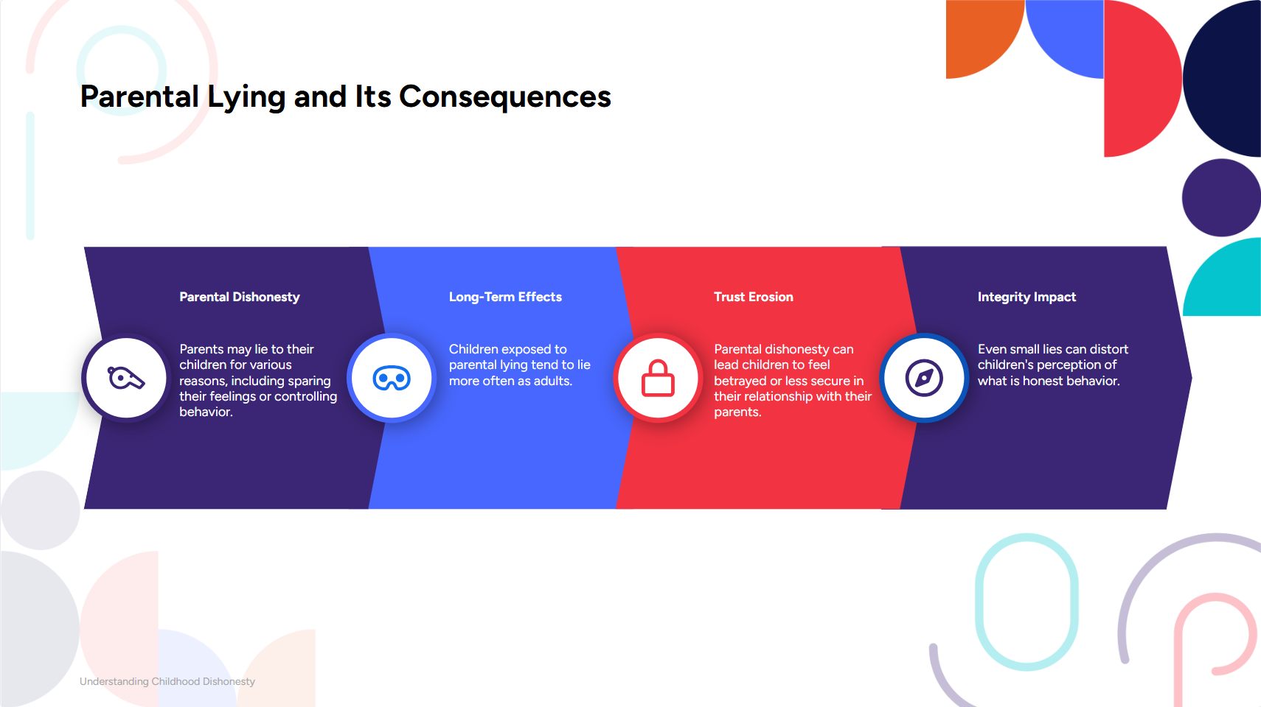
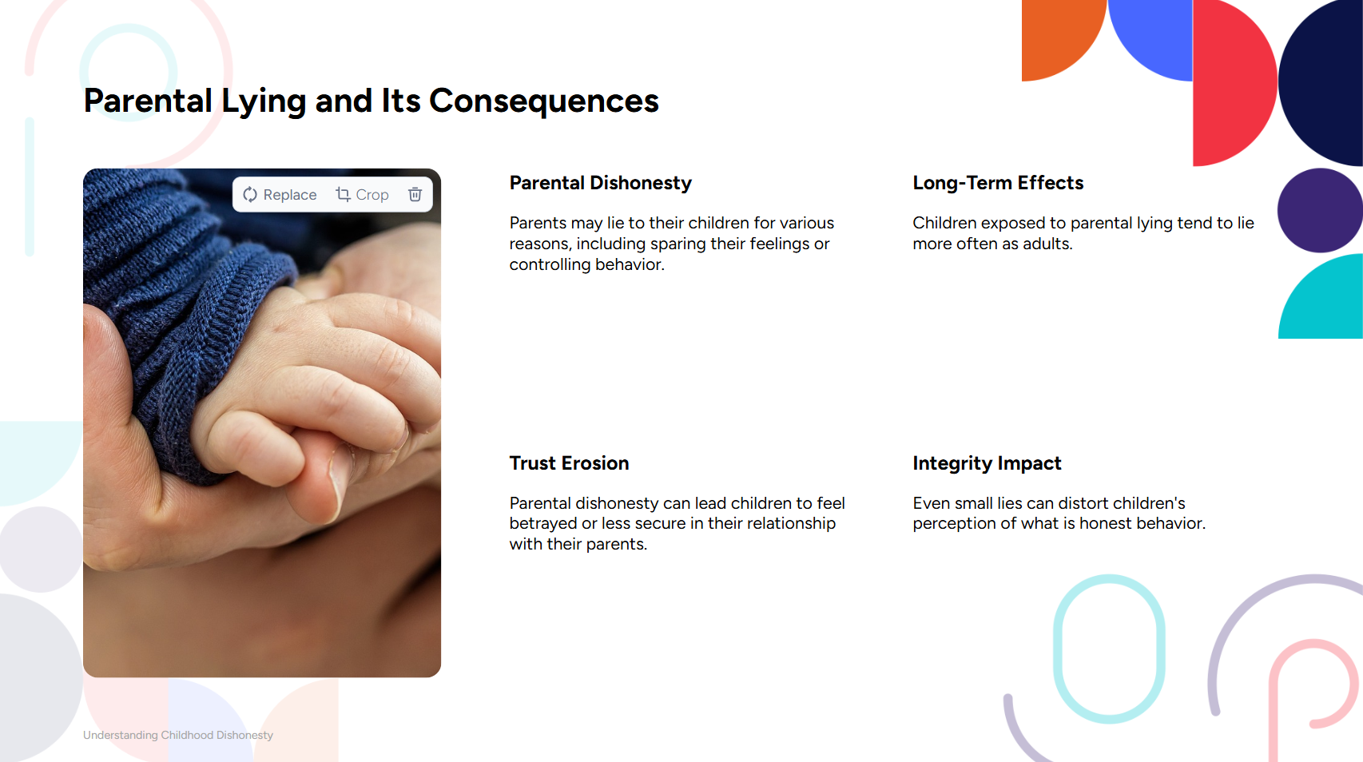



Slide 9
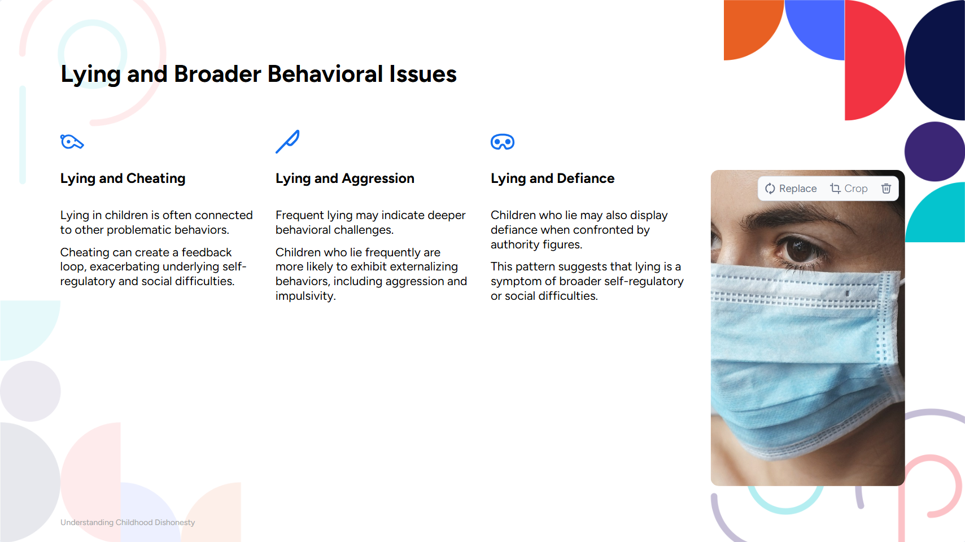




Slide 10
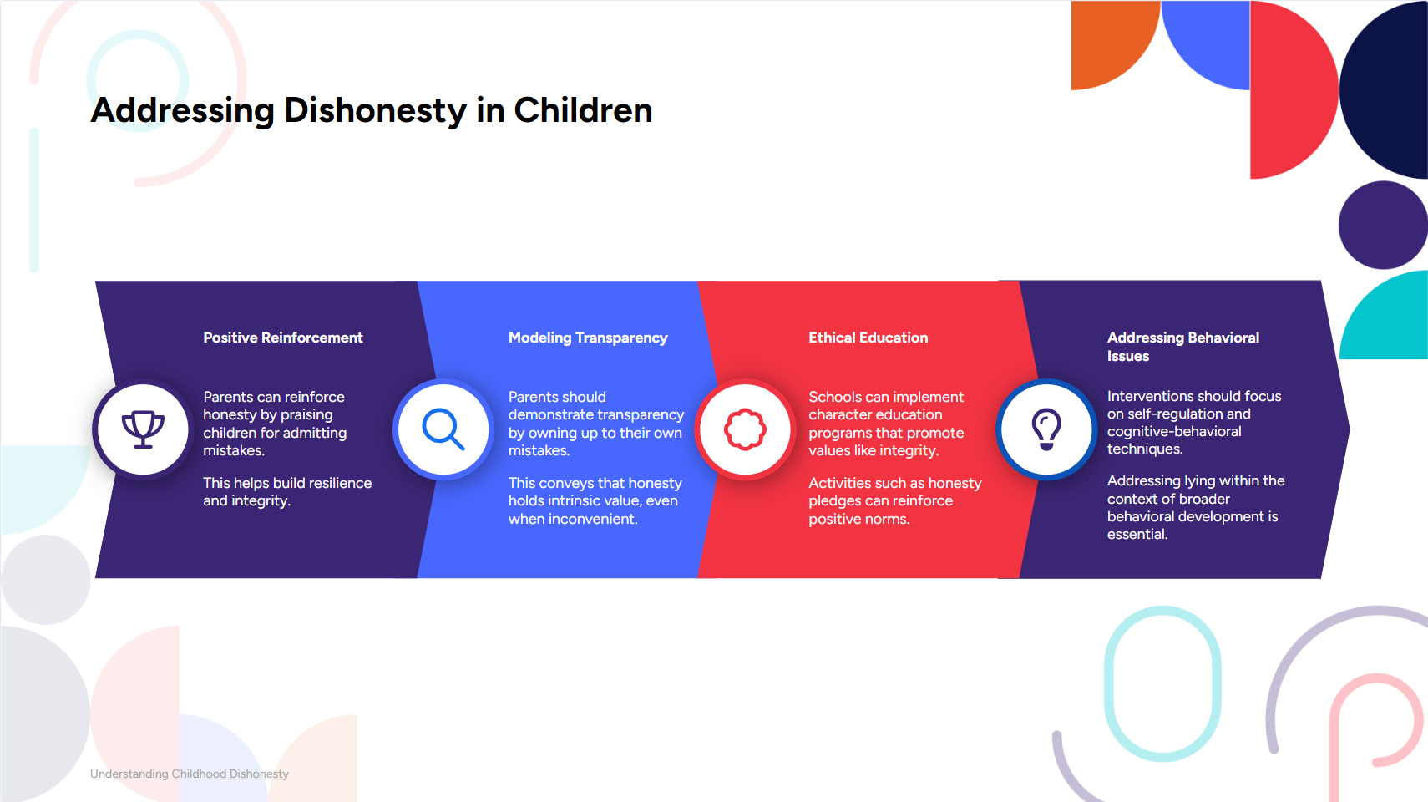



Slide 11
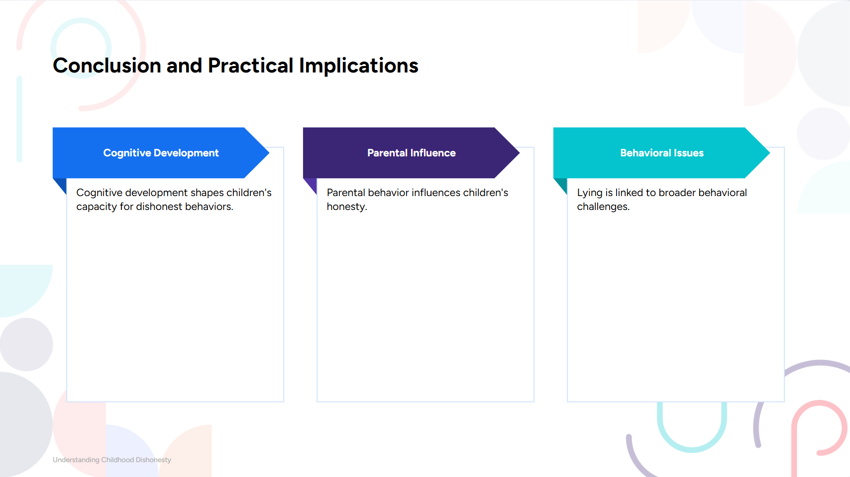
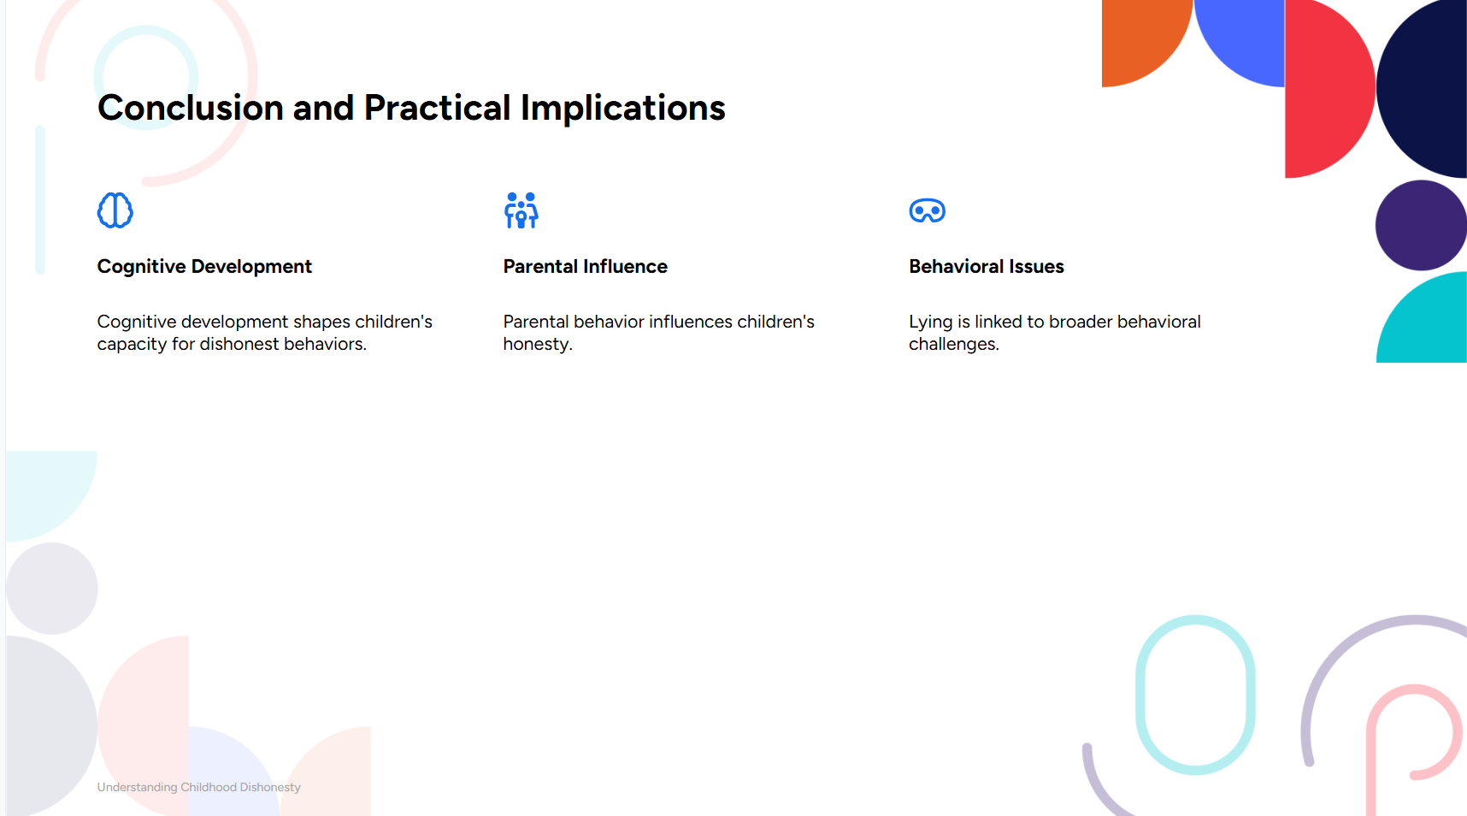
Fostering Honesty in Children
Cognitive Growth: Enables both deception and self-regulation.
Parental Influence: Honest modeling reinforces integrity.
Behavioral Links: Lying ties to aggression, requiring broader strategies.
Practical Steps:
Create integrity-focused environments.
Model honesty and celebrate truth-telling.
Interventions: Mindfulness & counseling for self-regulation.
Goal: Build a strong ethical foundation.

Slide 12
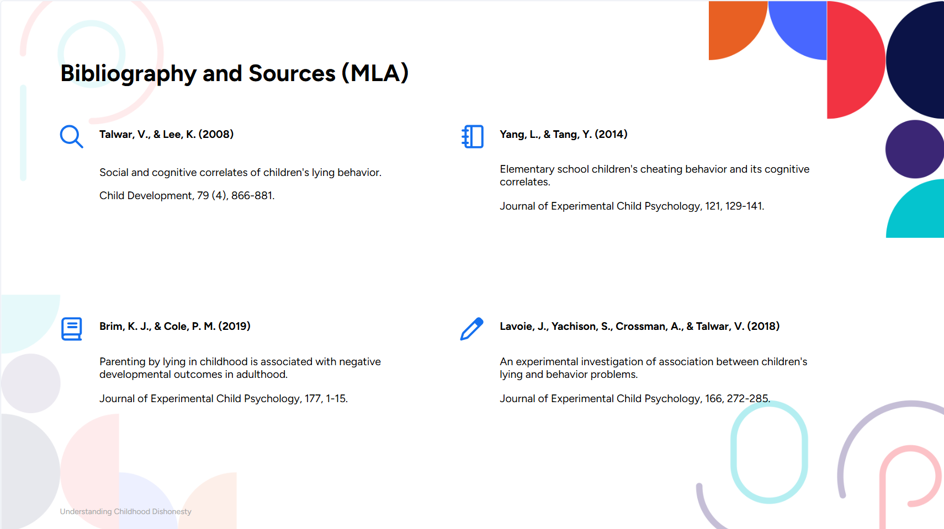
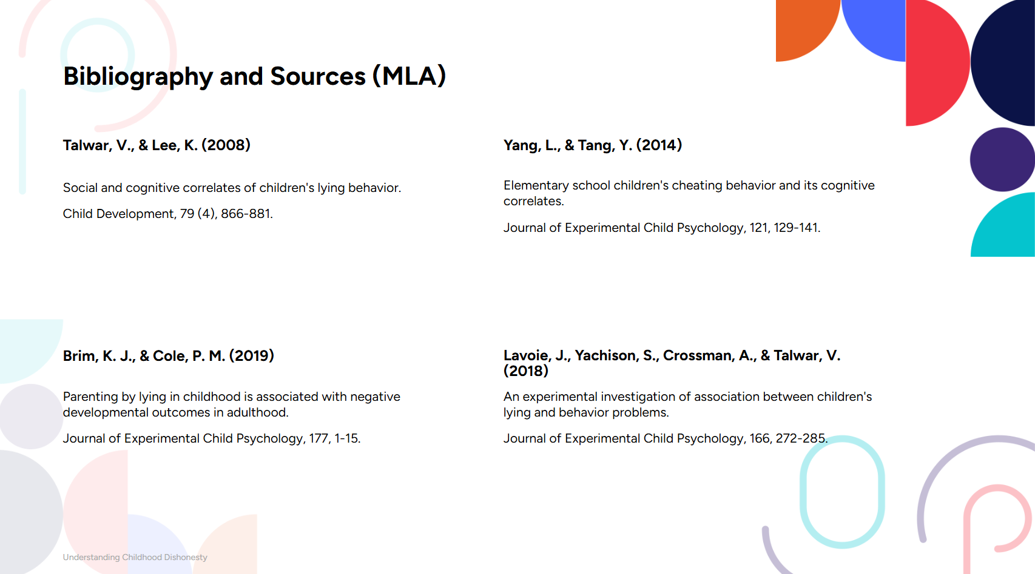



The Effects of Lying | Georgia Haukom | TEDxKids@ElCajon

